Slide 1

Using Ai technology to detect brain tumors
Faculty of Artificial intelligence engineering
محمد ميار كامل اسماعيل
اشراف الدكتورة: ماجدة البكور
كلية هندسة الذكاء الصنعي
قسم الذكاء الصنعي وعلوم البيانات

Slide 2
Brain Cancer: A malignant growth that originates in the brain or its surrounding tissues. It can be primary (originating in the brain itself) or secondary (metastatic, spreading from another part of the body). Brain tumors can be benign (non-cancerous) or malignant (cancerous).
Types of Brain Tumors: Common types include gliomas (the most common), meningiomas, and pituitary tumors.
Symptoms of Brain Tumors: Symptoms can vary depending on the tumor's location and size, but may include headaches, seizures, vision problems, nausea, vomiting, and changes in personality or behavior.
MRI Scans: A medical imaging technique that uses magnetic fields and radio waves to create detailed images of the body's internal structures. MRI scans are particularly useful for visualizing the brain and detecting abnormalities like tumors.
Importance of Early Detection: Early detection of brain tumors is crucial for successful treatment and improved patient outcomes. It allows for timely intervention, which can increase the chances of complete removal or effective management of the tumor. Early detection can also help prevent the tumor from spreading to other parts of the body.

Slide 3
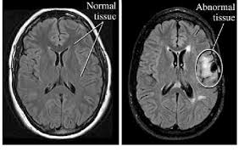
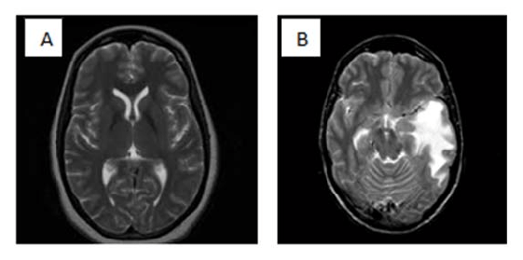
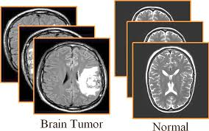
MRI pictures to show the difference between a normal brain and a brain with tumor

Slide 4
Project goals
This project aims to develop a robust and accurate AI-powered system capable of detecting brain tumors from MRI images. By harnessing the power of machine learning and deep learning algorithms, we seek to:
Improve Early Detection: Enhance the ability to identify brain tumors at an early stage, when treatment options are often more effective.
Assist Medical Professionals: Provide a valuable tool to aid radiologists and other healthcare professionals in diagnosing brain tumors more efficiently and accurately.
Enhance Patient Outcomes: Improve patient prognosis by enabling earlier intervention and more targeted treatment plans.
Advance Medical Research: Contribute to the advancement of medical imaging and AI applications in the field of oncology.
.

Slide 5
Project goals
Specific Objectives:
Develop a deep learning model that can accurately classify MRI images as containing or not containing brain tumors.
Implement data augmentation techniques to address the potential scarcity of labeled MRI images.
Evaluate the model's performance using relevant metrics, such as accuracy, precision, recall, F1-score
Consider ethical implications and potential biases in the model's predictions.
By achieving these goals, this project will contribute to improving the diagnosis and treatment of brain tumors, ultimately benefiting patients and advancing the field of medical imaging

Slide 6
MRI Picture
AI MODEL
(VGG16)
+
(Resnet101)
OUTPUT
[Classification]

Slide 7
Reference study
STUDY NUMBER | Study Year | DATASET USED | METHODS USED | OUTPUT
1 | 2023 | dataset of brain tumor MRI images. | YOLOv7. | accuracy of 99.5%.
2 | 2022 | a collection of MRI images containing both healthy brains and brains with tumors. | (CNN) (SVM) | 98.7% accuracy

Slide 8
STUDY NUMBER | STUDY YEAR | DATASET USED | METHODS USED | OUTPUT
3 | 2021 | 200 MRI image. the brain images of 12 patients | CNN | Accuracy: 99.5% Precision: 99.2 Recall: 99.7% F1-Score: 99.4%
4 | 2022 | BraTS dataset | DenseNet-121 convolutional neural network (CNN) | Accuracy (98.28)

Slide 9
STUDY NUMBER | STUDY YEAR | DATASET USED | METHODS USED | OUTPUT
5 | 2018 | BraTS 2015 | U-Net architecture, | (DSC) of over 0.9 for accuracy: 95.6%
6 | 2018 | BraTS 2017 | fully convolutional network (FCN) | Dice Similarity Coefficient (DSC) of 0.87 Accuracy 93.7%
7 | 2024 | My same Dataset | - YOLOv7 (for tumor localization) - Custom CNN | Accuraacy: 99.5% (binary tumor vs. non-tumor) 98.7% (multi-class)

Slide 10
My dataset
Previous data:
This dataset is a combination of the following three datasets :
figshare
SARTAJ dataset
Br35H
This dataset contains 7023 images of human brain MRI images which are classified into 4 classes: glioma - meningioma - no tumor and pituitary.
no tumor class images were taken from the Br35H dataset
The source is from Kaggle website
Link :https://www.kaggle.com/datasets/masoudnickparvar/brain-tumor-mri-dataset

Slide 11
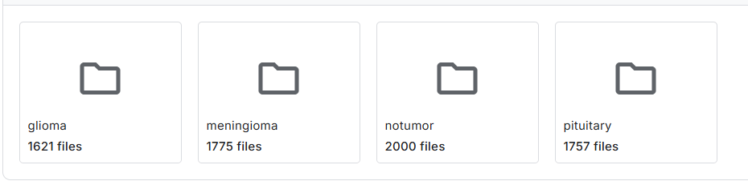
New Data
New MRI pictures taken from different sources with 7153 images. Same as the old one it’s classified to 4 classes
Combined with my old dataset
Current data sources:
https://figshare.com/articles/dataset/brain_tumor_dataset/1512427
https://www.kaggle.com/sartajbhuvaji/brain-tumor-classification-mri
https://www.kaggle.com/datasets/ahmedhamada0/brain-tumor-detection?select=no
Dataset link: https://www.kaggle.com/datasets/tombackert/brain-tumor-mri-data

Slide 12
Dataset description
The dataset now has a total of 14,176 human brain MRI images, categorized into four distinct classes. The dataset focuses on brain tumors and their classification. The four classes are as follows:
Glioma: Cancerous brain tumors in glial cells.
Meningioma: Non-cancerous tumors originating from the meninges.
No Tumor: Normal brain scans without detectable tumors.
Pituitary: Tumors affecting the pituitary gland, which can be cancerous or non-cancerous.
The "No Tumor" class images were obtained from the Br35H dataset in the old dataset.

Slide 13
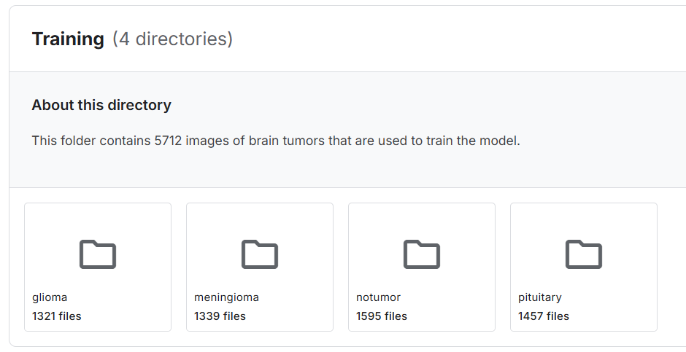
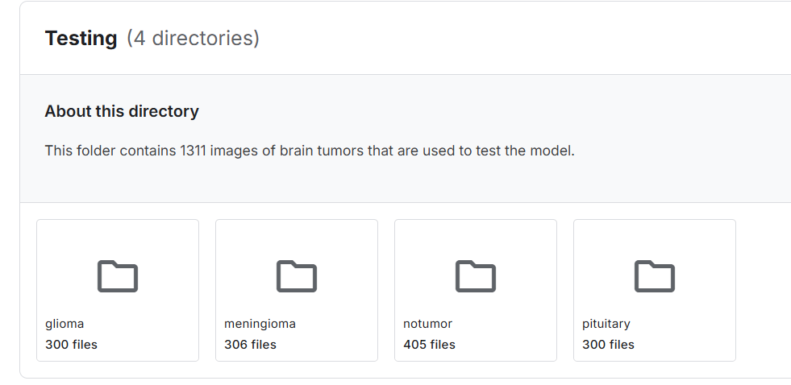
Dataset
The dataset size was 158 MB now 305 MB
It had 5712 images for training and 1311 images for testing
Now it has 11,56 images for training and 2,615 images for testing

Slide 14
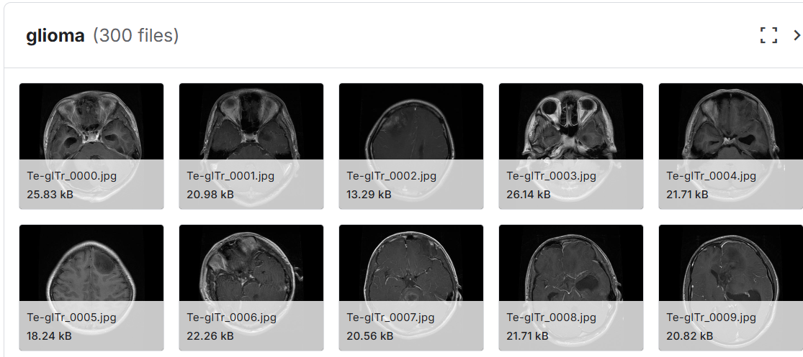
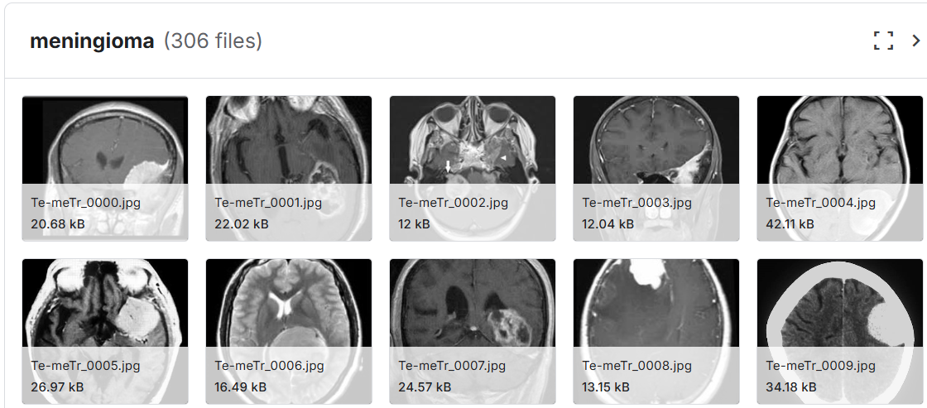
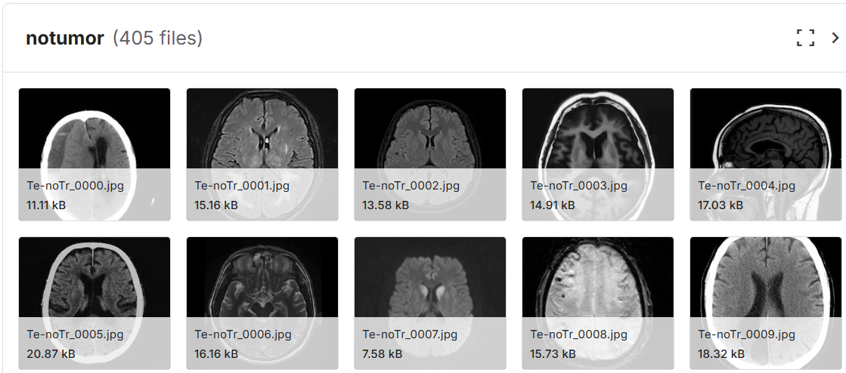
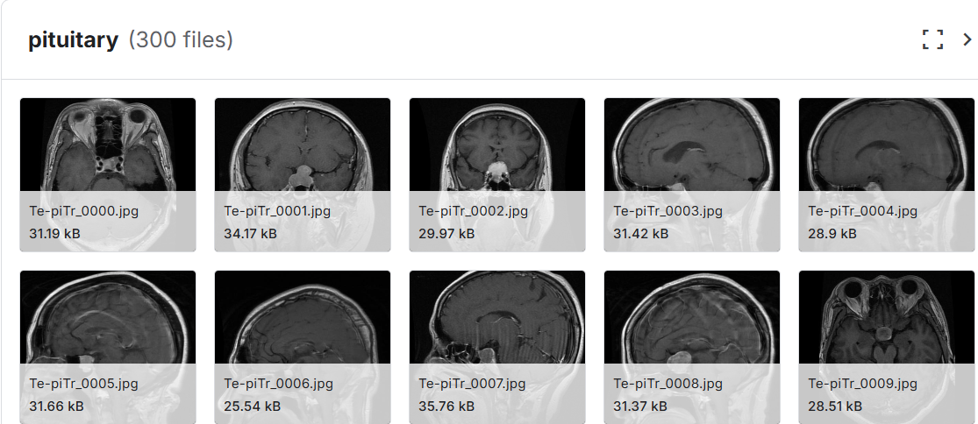
Dataset

Slide 15
What’s new ?
-New model (Restnet 101)
-Bigger and more diverse data
-Voting (Taking both Resnet101 and Vgg16)
Implementing on Android APP

Slide 16
Why vgg16 and resnet101?
(a) VGG16: Simplicity and Feature Extraction
Simple sequential architecture with 13 conv + 3 FC layers; easy to implement and fine-tune.
Small 3×3 filters capture subtle textures in MRI scans, useful for detecting tumor variations.
Works well on small-to-medium datasets (~2,000–5,000 images) with moderate overfitting risk.
(b) ResNet101: Depth and Residual Learning
101-layer deep network with residual (skip) connections to prevent vanishing gradients.
Captures complex, hierarchical features for subtle tumor characteristics.
Pretrained on ImageNet; fine-tuning last layers reduces overfitting despite depth.

Slide 17
Start
Reference study
Dataset cleaning
Preprocessing
Applying VGG16+ Resnet
Training
Testing
Evaluation
Output
End

Slide 18
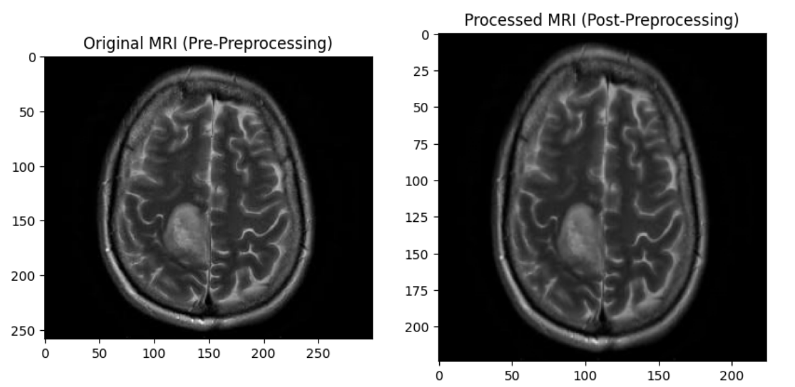
Preprocessing
The following preprocessing steps were applied uniformly to all MRI scans:
Skull Stripping:
Non-brain tissues removed using HD-BET algorithm
Normalization:
Pixel intensities rescaled to [0,1] range
Resizing:
Images standardized to 224×224 resolution using
bicubic interpolation
Dataset Splits:
Training: 70%
Validation: 12%
Test: 18%

Slide 19
VGG16 Model Architecture
Base Model Configuration
• Pretrained Weights: ImageNet
• Input Shape: 224×224×3 (RGB MRI slices)
• Frozen Layers: All but the last 10 layers
• Old Trainable Parameters: 2,097,412 / New Trainable Parameters : 13,833,988
• Regularization: 50% Dropout
Key Modifications from Original VGG16
• Removed original 1000-class FC layers
• Reduced final Dense layer to 4 outputs
• Added Dropout for improved generalization

Slide 20
Restnet 101 model architecture
Base Model Configuration:
Pretrained Weights: ImageNet
Input Shape: 224×224×3 (RGB MRI slices)
Frozen Layers: All layers except the last 20 layers of the ResNet50 base model
Trainable Layers: Last 20 layers of ResNet50 + added classification head
Trainable Parameters : 9,982,468
Regularization: 50% Dropout
Key Modifications from Original ResNet50:
Removed original 1000-class fully connected layer
Added new Dense layer with 4 outputs (for 4-class MRI classification)
Added 50% Dropout before final Dense layer for improved generalization

Slide 21
Data agumentation
The following augmentation techniques were applied to the training dataset using Keras' ImageDataGenerator:
• Rotation: Images randomly rotated up to 15 degrees
• Shifting:
Horizontal shift range: 10% of image width
Vertical shift range: 10% of image height
• Shearing: Intensity of 0.2 applied
• Zooming: Random zoom range of 20%
• Flipping: Horizontal flipping enabled
• Fill Mode: New pixels filled using nearest-neighbor interpolation
All images were normalized (pixel values scaled to [0,1]) and resized to 224×224 pixels to match VGG16's input requirements. The validation set used only rescaling (1./255) without augmentation to ensure unbiased evaluation

Slide 22
Data agumentation
Augmentation Details:
• 8× multiplier per training image (7 new augmented samples per original)
• Validation/test sets used original unaugmented images
• Class distribution maintained (ratio-preserving augmentation)
Class | Original Images | Augmented Training Set | Total (Train+Val+Test)
Glioma | 826 | 6,608 | 7,434
Meningioma | 822 | 6,576 | 7,398
Pituitary | 827 | 6,616 | 7,443
No Tumor | 395 | 3,160 | 3,555
Total | 3,070 | 22,960 | 25,830

Slide 23
Training (VGG16+Resnet101)
• Optimizer: Adam (learning_rate=0.0001)
• Loss Function: Categorical cross-entropy (changed from binary)
• Metrics: Accuracy, Precision, Recall
Training Protocol:
• Epochs: 20 (early stopping if val_loss plateaus for 5 epochs)
• Batch Size: 32
• Validation Split: 10% of training data

Slide 24
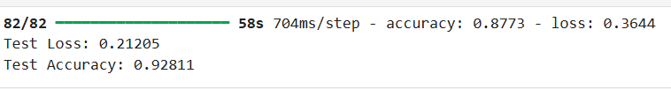
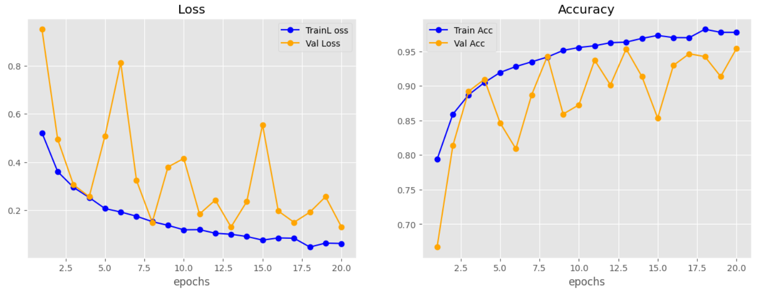
Accuracy and loss (resnet101)

Slide 25

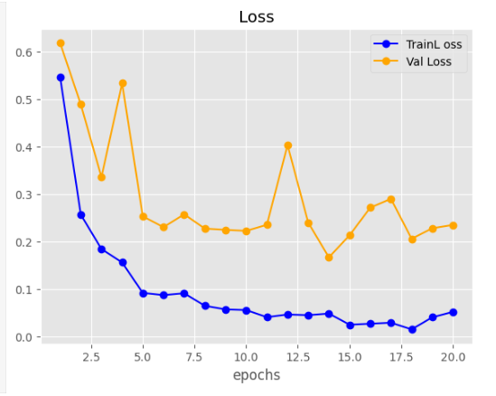
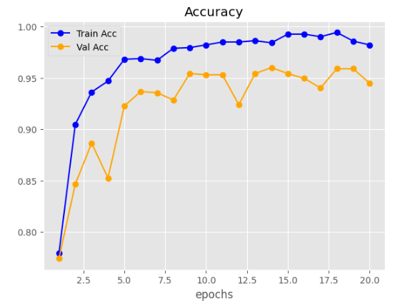
Accuracy & loss (Old vgg16)

Slide 26
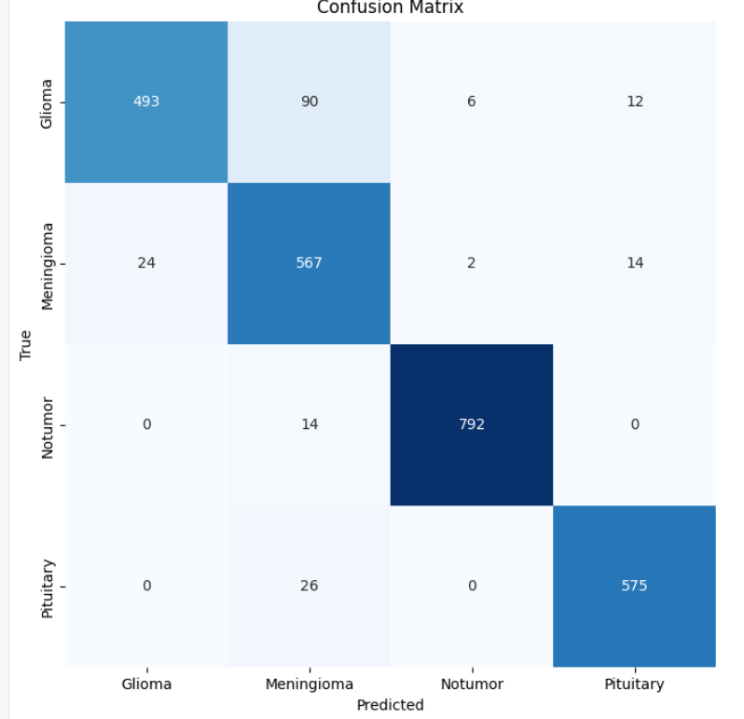
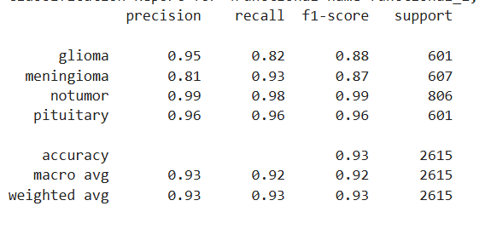
Confusion matrix (resnet101)

Slide 27
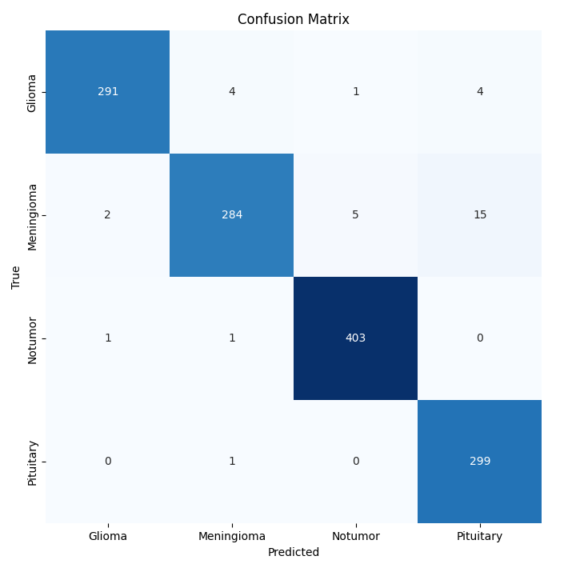
Confusion matrix old(vgg16)

Slide 29
System Requirements Specification
Functional Requirements
ID | Requirement Name | Description
FR1 | Image Upload | The user should be able to upload an MRI brain image from the phone gallery or capture a new one using the camera.
FR2 | Result Display | The system should display the classification result and the model’s confidence percentage.

Slide 30
Non-functional requirements
ID | Requirement Name | Description
NFR1 | Performance | The system should classify an image within 3–5 seconds.
NFR2 | Accuracy | The AI model should maintain a minimum accuracy of 90%.
NFR3 | Security | User images and results must be handled securely and not shared without permission.
NFR4 | Usability | The app interface should be clear and easy to use by non-technical users.
NFR5 | Reliability | The system should operate correctly under normal conditions without crashes.
NFR6 | Compatibility | The app must support Android 10 and above.
NFR7 | Maintainability | The code should be modular and well-documented for easy maintenance.
NFR8 | Availability | The app should be available and responsive 24/7 when used offline or online.

Slide 31
Requirements Traceability Matrix (RTM)
ID | Requirement Name | Type | Priority | Dependency
FR1 | Upload MRI Image | Functional | High | Start App
FR2 | Preprocess Image | Functional | High | Upload Image
FR3 | Classify Image using VGG16 | Functional | High | Preprocess Image
FR4 | Display Result with Accuracy | Functional | High | Classify Image
FR5 | Save Result | Functional | Medium | Display Result
FR6 | View History | Functional | Medium | Save Result

Slide 32
RTM
ID | Requirement Name | Type | Priority | Dependency
NFR1 | Performance (≤5s per image) | Non-Functional | High | —
NFR2 | Accuracy ≥ 90% | Non-Functional | High | —
NFR3 | Security | Non-Functional | High | —
NFR4 | Compatibility (Android ≥ 10) | Non-Functional | Medium | —
NFR5 | Usability | Non-Functional | Medium | —

Slide 33
Activity diagram
Step No. | Activity Name | Description
1 | Start | The user opens the application.
2 | Upload Image | The user selects or captures an MRI image.
3 | Validate Image | The system checks that the uploaded file is a valid image.
4 | Preprocess Image | The system resizes and normalizes the image for analysis.
5 | Classify Image | The VGG16 model predicts if a tumor exists and determines its type.
6 | Display Result | The result is shown on screen (Tumor type + Confidence %).
7 | Save Result | The result and image path are saved in the database.
8 | View History (optional) | The user can view previously analyzed images and results.
9 | End | The process ends when the user exits or performs another test.

Slide 34
Upload image
Field | Description
ID | FR1
Title | Upload MRI Image
Type | Functional
Priority | High
Description | User selects an MRI image from the phone’s storage.
Pre-conditions | App installed, storage permission granted.
Post-conditions | The MRI image is loaded into the app.
Primary Actor | User

Slide 35

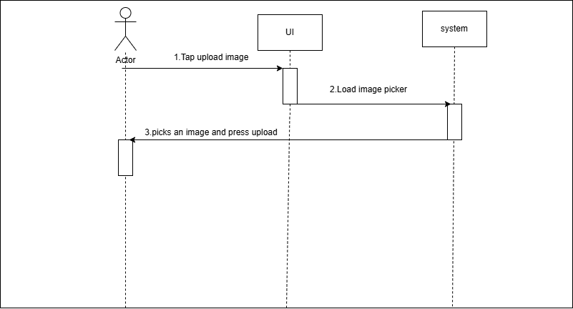
Upload image

Slide 36
Send Image to ML model
Step | Description
1 | The user taps “Analyze Image”.
2 | The system preprocesses the image.
3 | The system sends the image to the ML model.
4 | The system waits for the model's output.
5 | The model returns results.

Slide 37
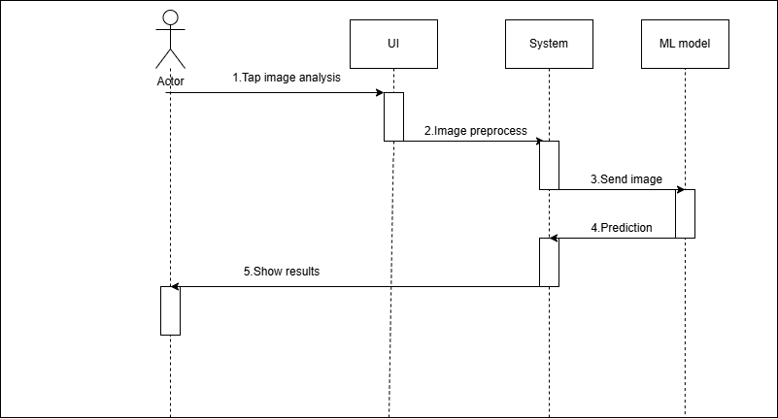
Send image to ml model

Slide 38
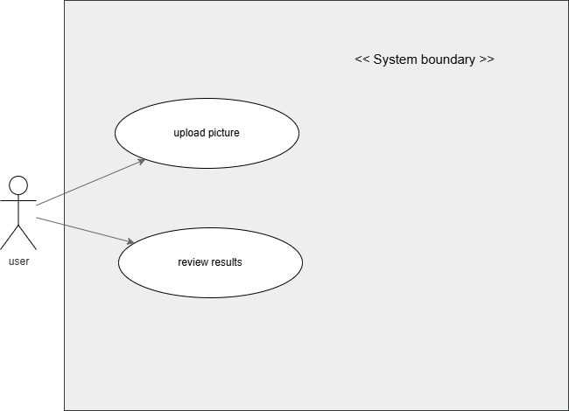
Use case diagram

Slide 39
Recommendations for Improving Brain Tumor Classification
1. Dataset Enhancements
Expand the dataset with more diverse MRI scans, especially underrepresented tumor types.
Include MRIs from different machines and patient demographics for better generalization.
2. Model & Training Improvements
Experiment with modern architectures like EfficientNet or ResNet50 for comparison.
Optimize hyperparameters (learning rate, batch size) using Keras Tuner or Optuna.
Use medical-specific pretrained models (e.g., RadImageNet) instead of ImageNet weights.

Slide 40
